Slide 1
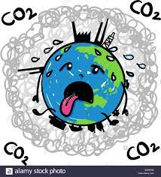
Project 3: Global Warming
A Dictionary of Data Analists presents:
By: Tanya Adams, Allison Brown, Michaela Giandello,
& Zachary Griffin

Slide 2
Table of Contents
Introduction
Our Story
Contributing Factors to Global Warming
Deforestation
Carbon Emissions
Natural Disasters
Global Temperatures
Summary
Sources
Questions

Slide 3
Table of Contents
Introduction
Our Story
Contributing Factors to Global Warming
Deforestation
Carbon Emissions
Natural Disasters
Global Temperatures
Summary
Sources
Questions

Slide 4
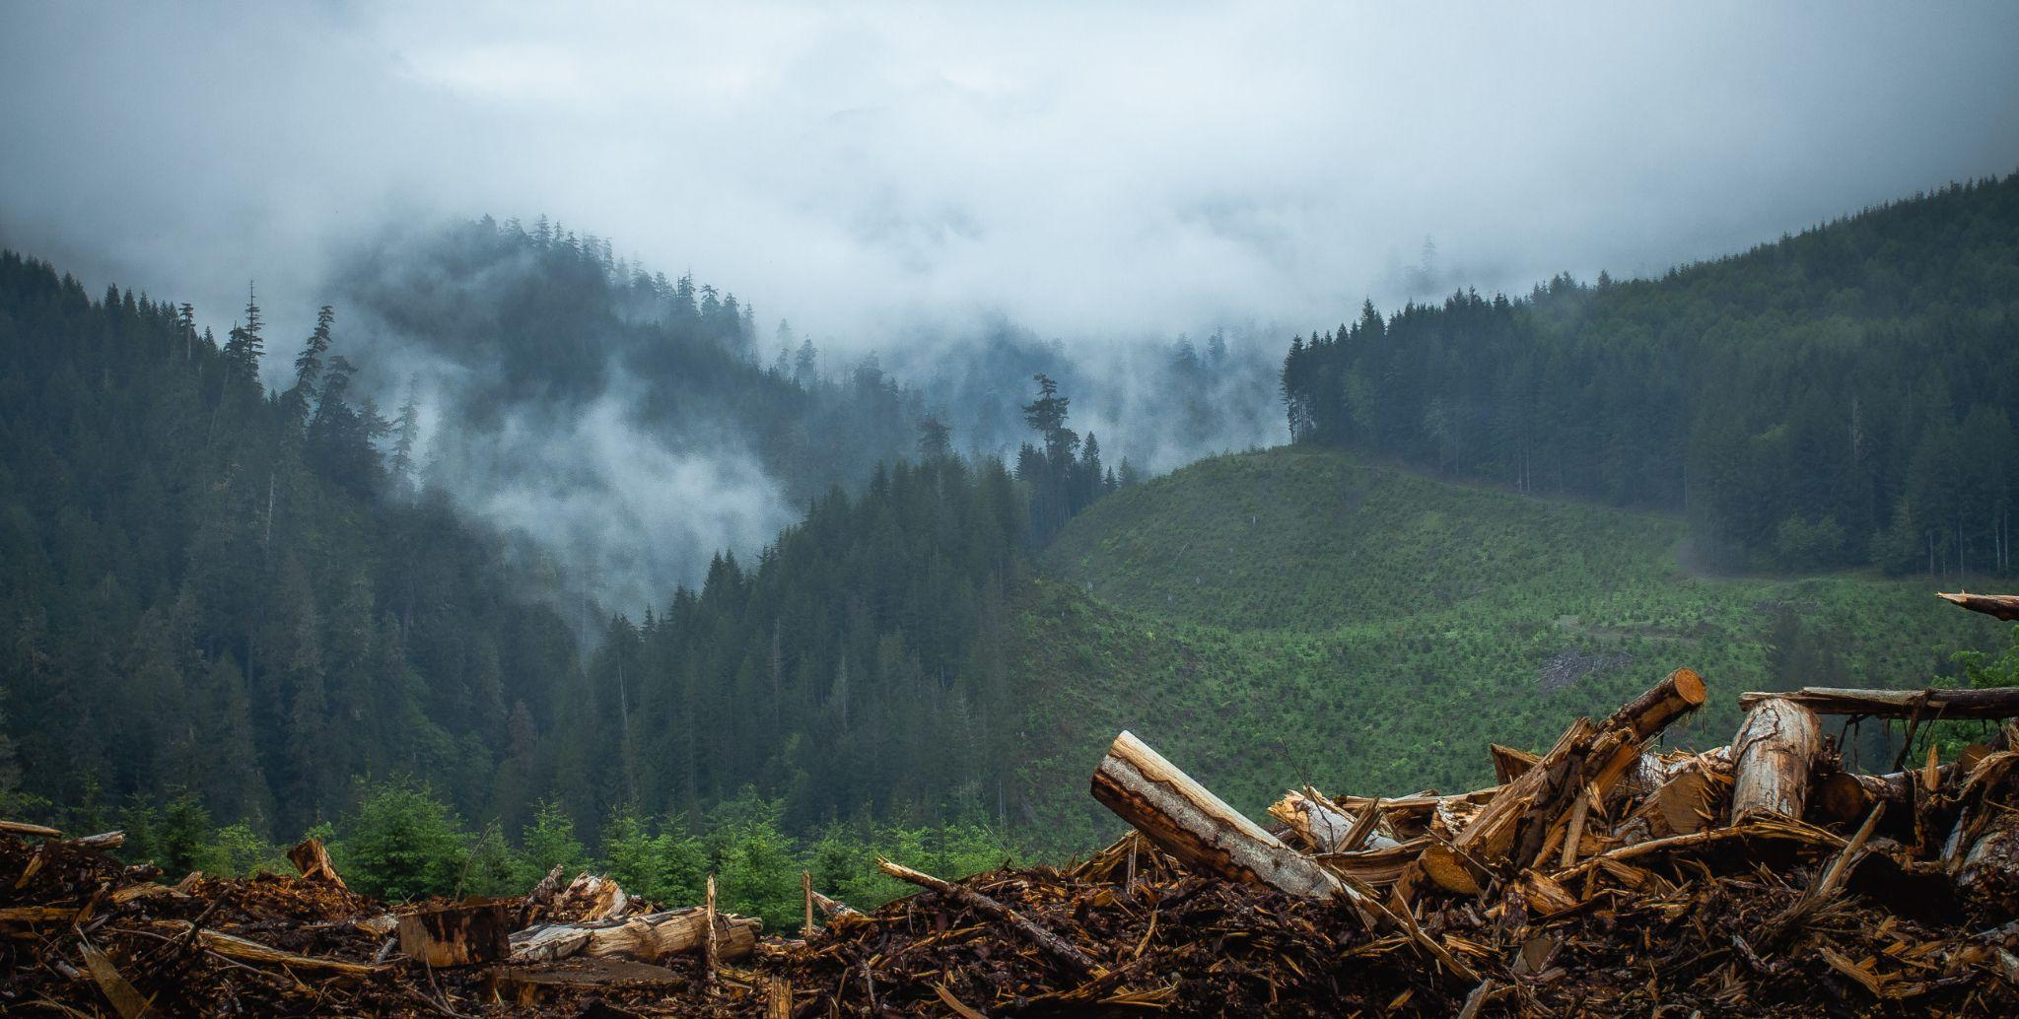
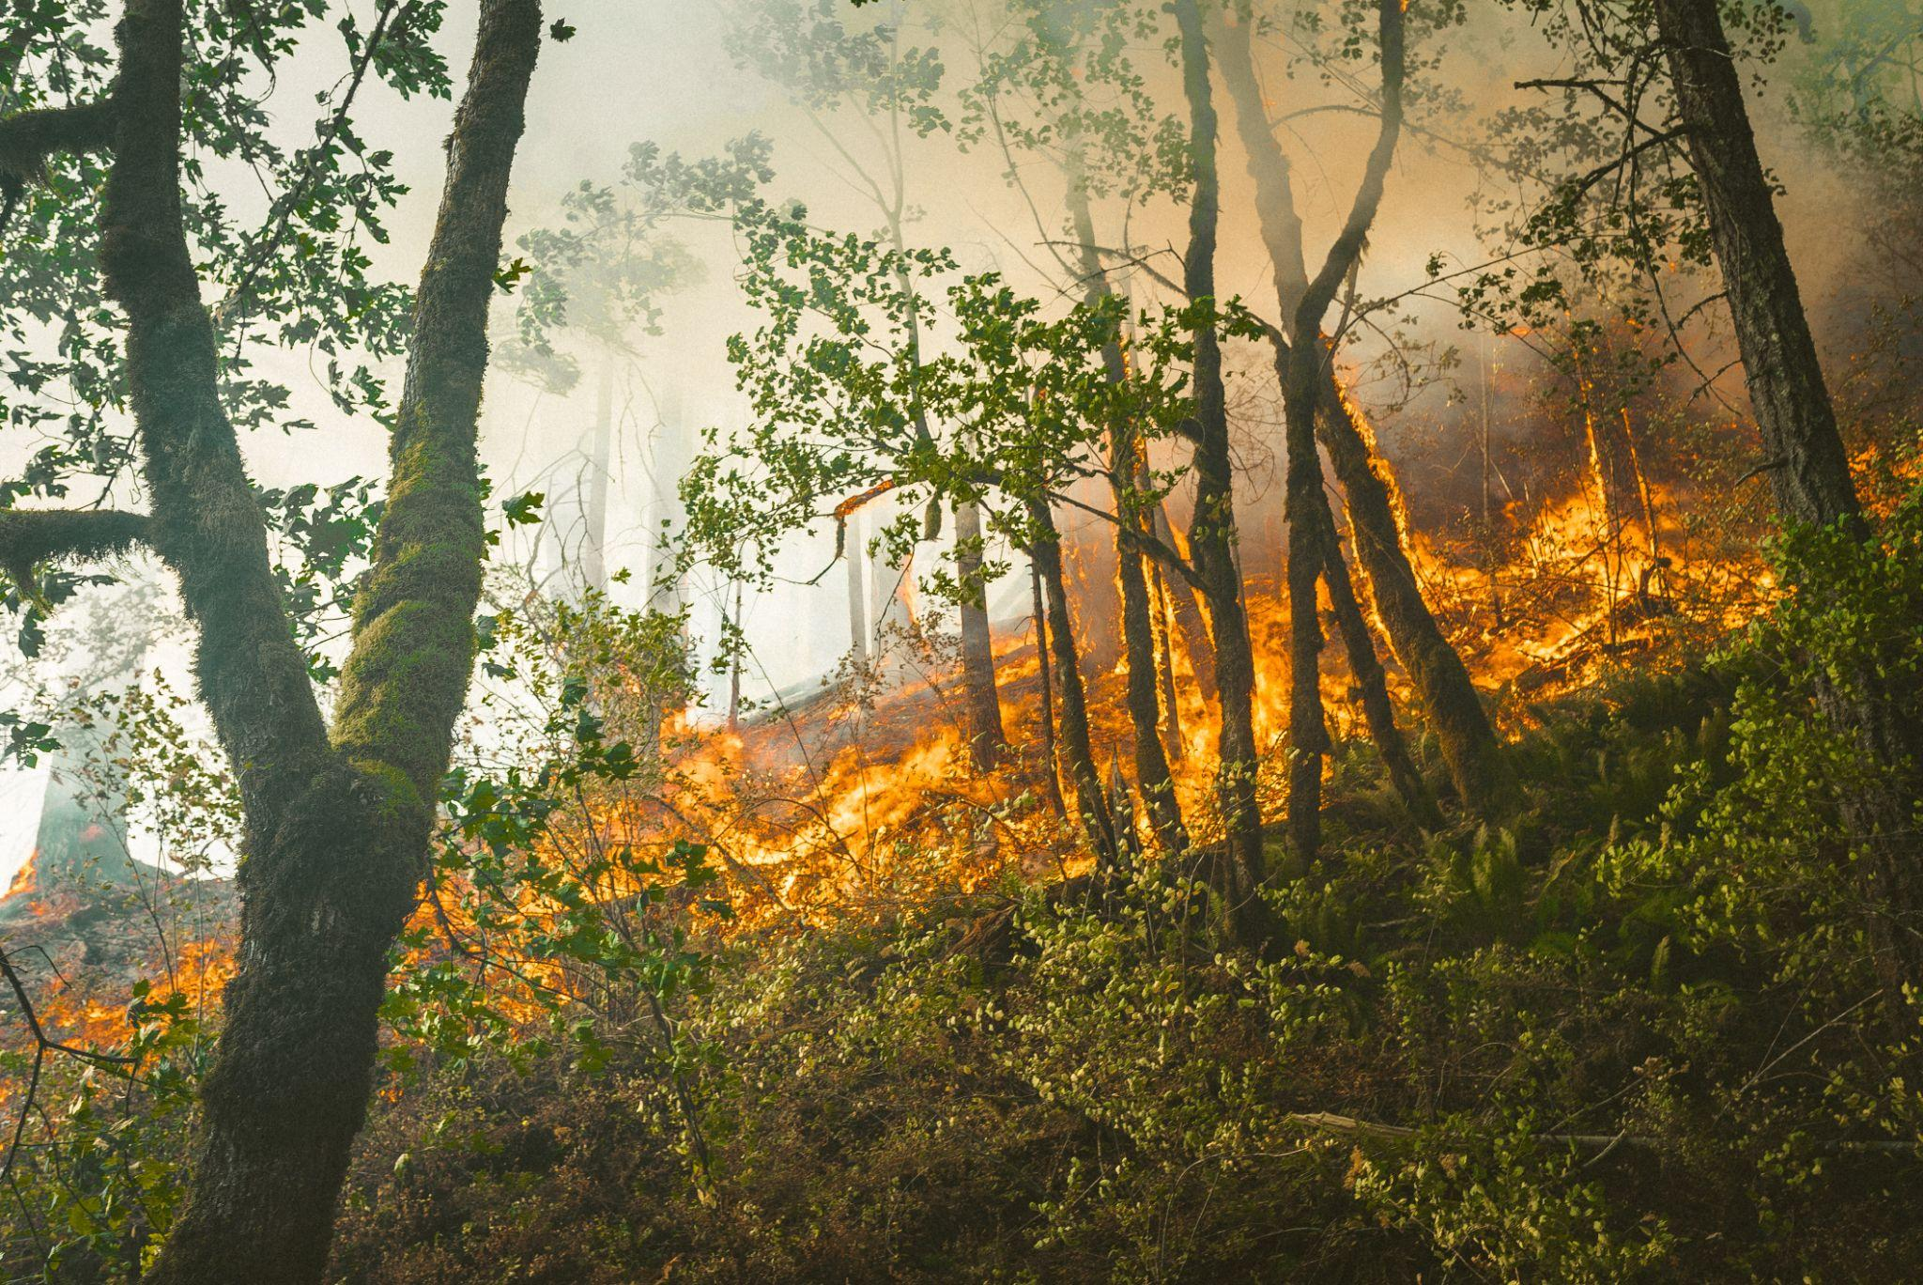
Deforestation vs. Forest Loss/Degradation
Deforestation is considered to be more permanent and drastic typically driven by demand for commodities and civil development.
Forest loss is considered to be temporary and can be driven by more “natural” causes
Photo by Jonathan Lampel on Unsplash
Photo by Karsten Winegeart on Unsplash

Slide 5
Deforestation: The Five Drivers
Commodity-driven deforestation: Large-scale deforestation linked primarily to commercial agricultural expansion.
Shifting agriculture: Temporary loss or permanent deforestation due to small- and medium-scale agriculture.
Forestry: Temporary loss from plantation and natural forest harvesting, with some deforestation of primary forests.
Wildfire: Temporary loss, does not include fire clearing for agriculture.
Urbanization: Deforestation for expansion of urban centers.
The Sustainability Consortium, World Resources Institute, and University of Maryland. “Tree Cover Loss by Driver.” Accessed through Global Forest Watch on 25/12/2021. www.globalforestwatch.org.

Slide 6

What the heck is a hectare?!!
Comparisons for context
A hectare is a unit of measuring area
1 hectare = 2.47 acres or for context approx. 2.5 football fields
The dataset measures forest loss in 1000’s of hectares annually
1000 hectares = 3.86 square miles
Who is contributing to deforestation abroad?, 2013
https://ourworldindata.org/grapher/imported-deforestation?country=~LVA
Photo by Ameer Basheer on Unsplash

Slide 7
Future development
Acquire ISO 3166 numeric codes to add to the data set to render maps for the data
Develop more in-depth interactive grouped bar graphs that allow the viewer to choose and toggle the data
Comparing 1 or multiple countries over time.
Comparing Imported to Net Traded for 1 or more countries in a year or over a span of years.
Viewing per Capita data
Share of global forest cover

Slide 8
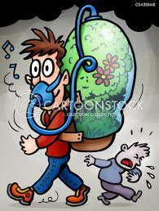
Carbon Emissions
Data Overview:
Annual change in carbon dioxide concentration and fossil carbon dioxide emission over the past 40 years
Carbon dioxide emission trend of top 5 contributors
China, U.S., India, Russia, Japan
Coal, oil, geothermal, natural gas, non-biomass, petroleum, residual power sector CO2 emissions
Matplotlib, Plotly

Slide 9
Natural Disasters
Records are available as far back as 1900 and into 2021.
Emdat has an interactive map to view world natural disasters.
Used SQL, Python (jupyter notebook), D3/Json, Bootstrap, Popper.js, and html/css

Slide 10
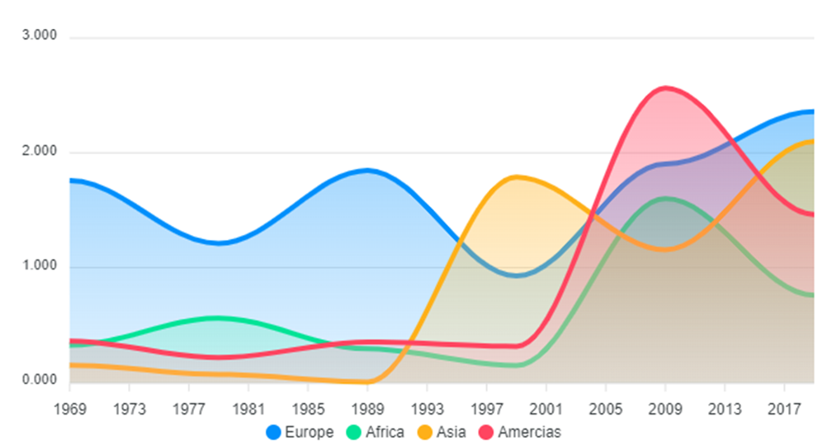
Temperature Change
Date ranges from 1969 - 2019
Four regions of the world
Europe, Africa, Asia, Americas
Asia had the highest temperature increase: 1.95 degrees C
Africa had the lowest: 0.465 degrees C
Americas had the largest spike
Europe had the most erratic change over time
ApexCharts

Slide 11
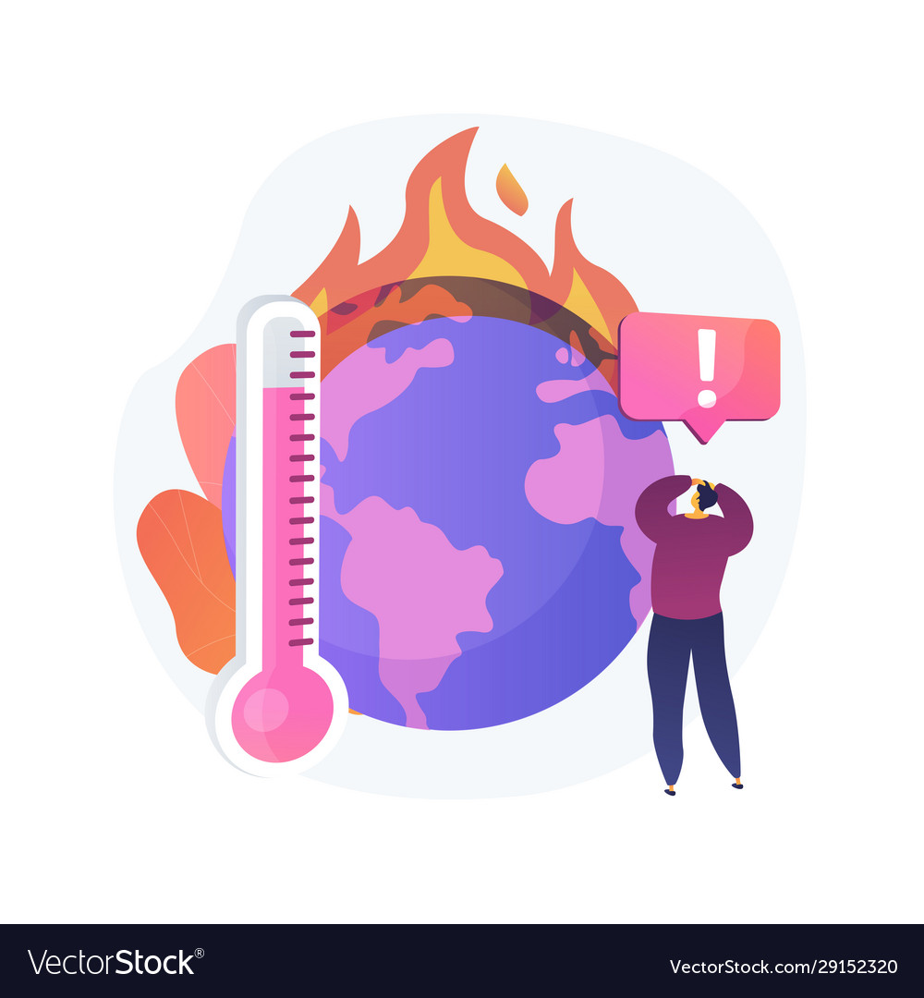
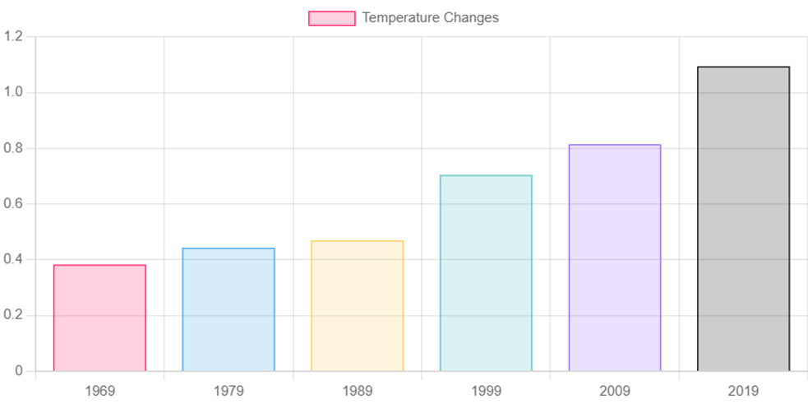
Temperature Change Cont.
Global change in temperature every 10 years
Global temperature has increased by a little over 1 degree celsius
For reference: 1 degree C = 33.8 degrees F

Slide 12
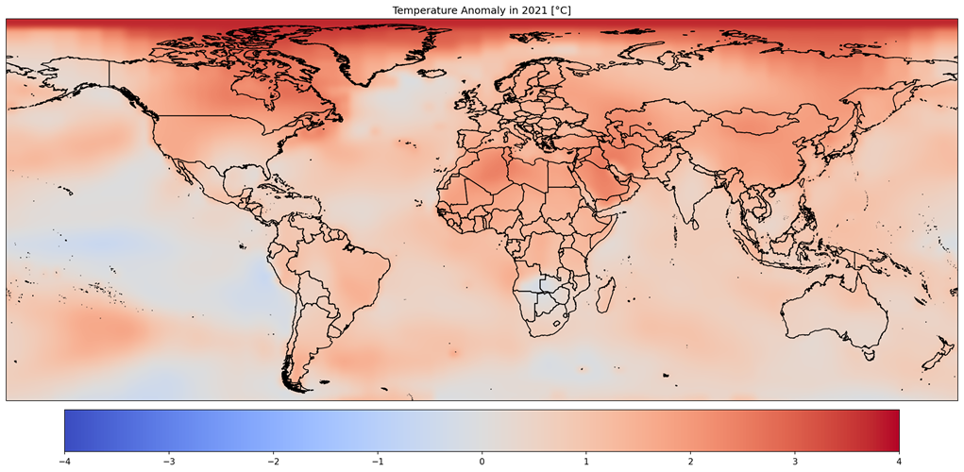
Temperature Change Cont. Again
Nasa data from 2021 displaying ocean and air temperature anomalies
Matplotlib, Pandas, Xarray

Slide 13
Sources
https://www.kaggle.com/aa3aa3/carbon-dioxide-emission?select=CO2_GlobalTrend.csv
public.emdat.be - The International Disaster Database - Natural Disaster Classification
Public.emdat.be confirmed information provided by https://www.kaggle.com/jnegrini/emdat19002021
https://data.giss.nasa.gov/gistemp/
https://www.kaggle.com/sevgisarac/temperature-change
https://ourworldindata.org/grapher/imported-deforestation
https://ourworldindata.org/deforestation?country=#do-rich-countries-export-deforestation-to-other-countries
https://fra-data.fao.org/WO/fra2020/forestAreaChange/
https://fra-data.fao.org/WO/fra2020/dataDownload/
https://raw.githubusercontent.com/owid/co2-data/master/owid-co2-data.csv

